Slide 1
Project Phoenix
Web development application
J SUSHMANAA CHOWDARY
1602-16-737-051

Slide 2
PROBLEM STATEMENT

Slide 3
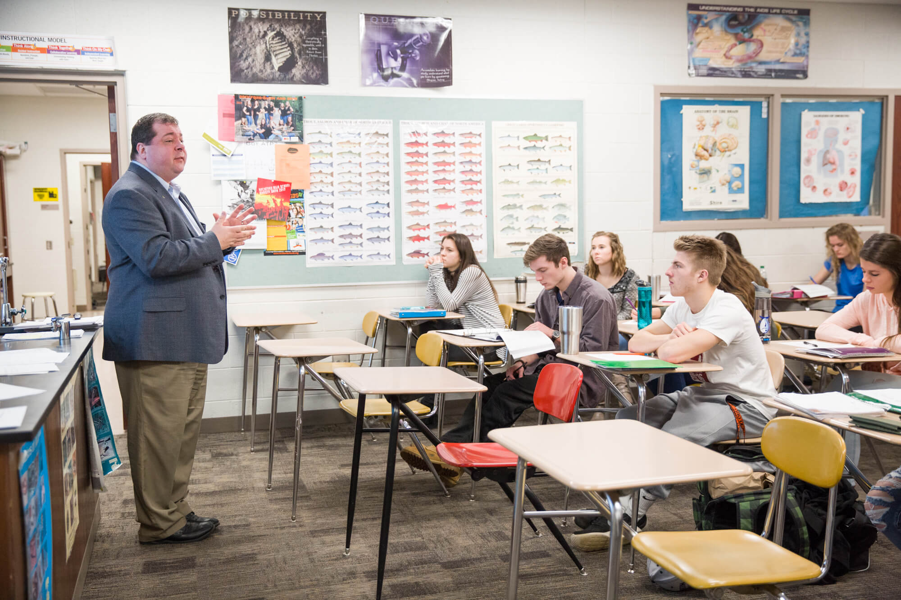
MISSED CLASS…?
FORGOT WHAT SIR SAID…?
NEED REVISION AT LAST MINUTE OF EXAM…?

Slide 4
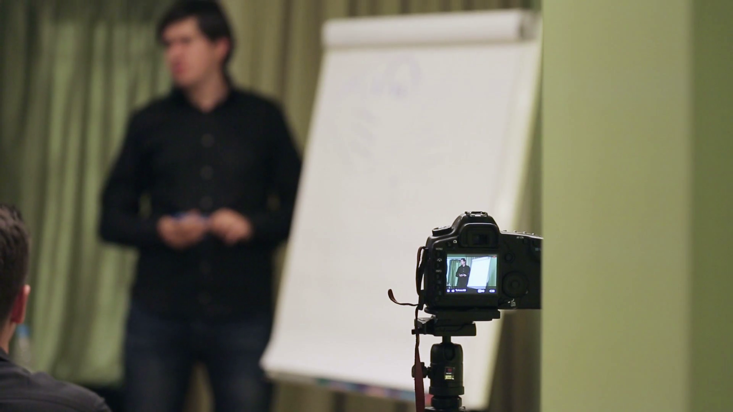
TAKE A VIDEO AND UPLOAD…
PROBLEM SOLVED…

Slide 5

WHERE TO START…?

Slide 6

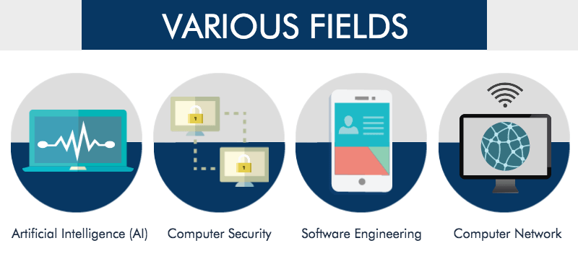

Slide 7



Slide 8

YOU WILL HAVE GUIDANCE…!
PROBLEM SOLVED…

Slide 9

NEED HELP..?

Slide 10
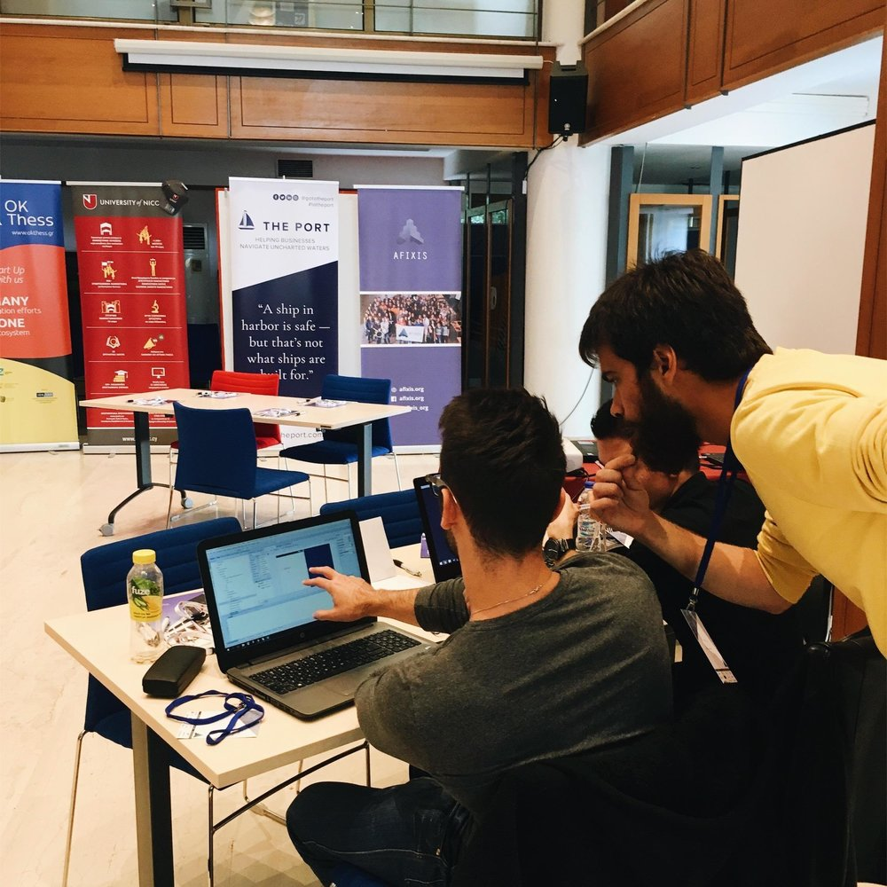
YOU CAN FIND A MENTOR…?
PROBLEM SOLVED…

Slide 11
MENTOR
CREATE A ACOUNT .
PROVIDE DETAILS REGARDING YOUR ACADEMIC QUALIFICATIONS
PROVIDE DETAILS RAGARDING YOUR EXPERTISED FIELDS
PROVIDE DETAILS REGARDING YOUR PROJECTS
READ REQUESTS FROM STUDENTS AND ACCEPT ONE
HELP HIM IN CHOOSING HIS COURSES.
HELP HIM IN COMPLETING THE COURSE AND UNDERSTAND THE SUBJECT.
GET TO KNOW HIS PROJECT AND GIVE TIPS AND SUGGESTIONS
…WHICH SOFTWARES TO USE
…WHICH PART OF PROJECT SHOULD BE DONE FIRST
CLARIFY HIS DOUBTS AND HELP IN COMPLETING THE PROJECT .

Slide 12
STUDENT
LOGIN
SEARCH FOR MISSED LECTURES AND WATCH THEM.
READ INFORMATION RELATED TO DIFFERENT FIELDS
CHOOSE ONE AND SEARCH FOR REALTED COURSES
GO FOR IT AND IMPROVE YOURSELVES
NEED HELP…? SEARCH FOR MENTORS BASED ON YOUR NEED
TAKE HELP , WORK TOGETHER AND COMPLETE

Slide 13

LESS CONFUSION..
LESS STREES..
IMPROVE FASTER..
INCREASED CONFIDENCE..

Slide 14
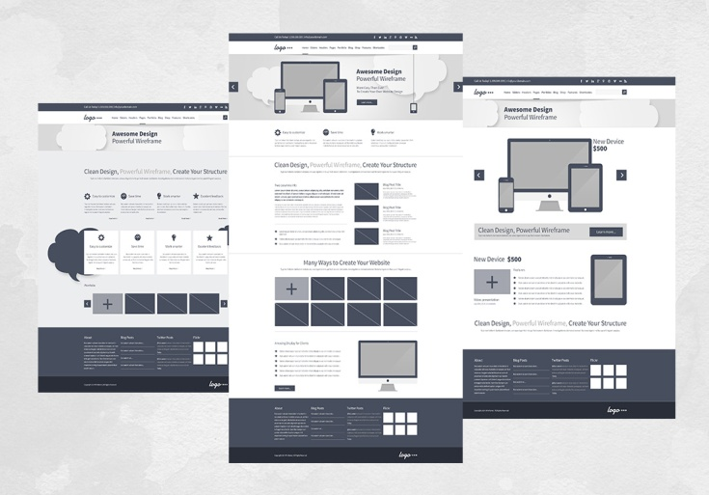
BASIC ARCHITECTURE
HOME PAGE
DISPLAYING REGISTERED COURSES
SUGGESTIONS
INFORMATION ABOUT YOUR MENTOR
INFORMATION PROVIDED BY YOUR MENTOR
LINKS..

Slide 15

LECTURE VIDEOS
SEARCH FOR MENTORS
CHOSE THE FIELD
CHOOSE SPECIFIC EXPERT
SEARCH FOR COURCES
CHOOSE THE FIELD
CHOOSE THE BEST COURSE
READ INFORMATION ABOUT DIFFERENT FIELDS

Slide 16

SOFTWARES
BOOTSTRAP
DJANGO
MySQL

Slide 17
Abstract
Purpose:
Project Phoenix web app is helpful to make the life of the college students easier.
Provides class room lecture videos.
Guidance for projects, courses by providing expert mentors in various fields.
Review tool which is required for the betterment of the application.
Problem:
Missed the classes, forgotten the lecture explained by the faculty , want to revise the important concepts.

Slide 18
Confused about what courses to be completed and what projects are to be done in the span of course study.
Here’s the solution for such problems in a better and efficient way.
Methods:
Class room videography is one of the method to solve the problem.
Providing guidance for the career making factors.
Receiving the feedback for the betterment of the task performed by the application.

Slide 19
Results:
Reduce confusion and lead the student towards better path.
Increase confidence towards a technical field to perform a task .
Conclusion:
Web application as a student advisor to guide on courses, projects and class room lectures.
The application also involves special features.

Slide 20

THANK YOU

